Slide 1
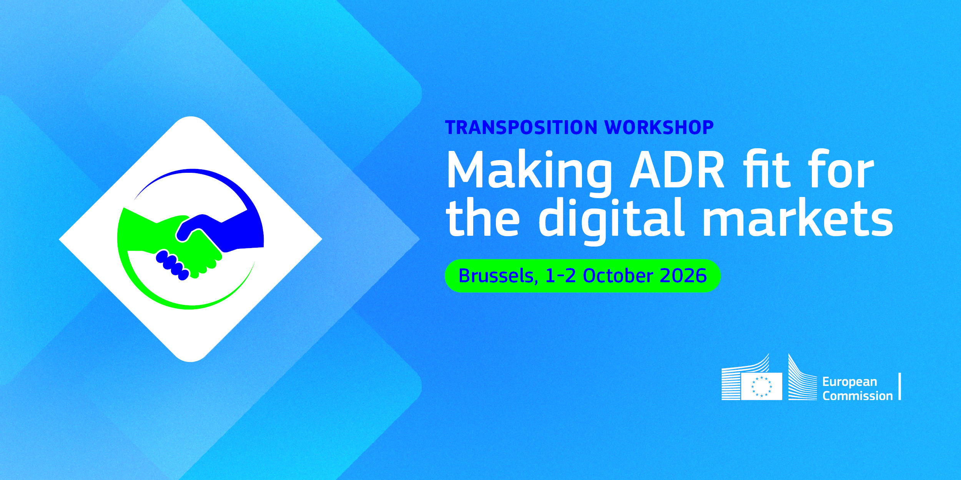

Slide 2
Incentives on
traders’ engagement
Moderator: Vlad Florin Vîță
Policy Director, Ecommerce Europe

Slide 3



Outline
01
02
03
04
Incentives for traders
Platforms and authorities
Conditions for success
Discussion

Slide 4

01
Incentives for
traders

Slide 5
01 Financial incentives
Shared, predictable, low cost
Cost pooling: ADR included in membership
Case allowance scaled to distance-selling turnover, modest fee beyond
Far cheaper than litigation, and predictable for SMEs
Other models: sector funds, lower fees, SME support

Slide 6
01 Reputational incentives
Reward visible commitment
Link ADR commitment and use to trust marks or labels
Present ADR as a customer retention tool
A well-resolved dispute often keeps the customer
Highlight good practice rather than name and shame

Slide 7
01 Regulatory incentives
Mandatory access, voluntary engagement - France
Hybrid model: traders must offer access to ADR
Backed by administrative sanctions
Taking part and following the outcome stay voluntary
20-working-day reply duty forces a clear answer
Enforcers could credit good-faith participation

Slide 8
02
Platforms and
authorities

Slide 9
02 Platforms and marketplaces
Build ADR into the complaint journey
Clear escalation to ADR once customer service fails
Consumers should not have to search for ADR
ADR commitment in third-party seller terms
A “covered seller” label to signal it
Clarify platform-level and seller-level ADR

Slide 10
02 Faster case handling
Speed through smarter procedures
Upstream admissibility screening
Simplified procedures for low-value claims
Fully digital exchanges
Many disputes share one cause, e.g. delivery
Grouping similar cases helps high-volume traders

Slide 11
02 Public authorities
Make trust visible, target support
ADR entities are already assessed and listed
Certification must be visible to consumers
More than a line in the terms and conditions
Awareness campaigns in low-participation sectors
Targeted SME support rather than general funding

Slide 12
03
Conditions for
success

Slide 13
03 Conditions for success
Trust matters as much as cost
Incentives must protect independence and impartiality
Extra care with trader-funded sector schemes
Refusals stem more from perceived bias than cost
Many traders do not know outcomes are non-binding
Awareness-raising matters as much as funding

Slide 14
04
Discussion

Slide 15
04 Discussion
Over to you
01
What financial, reputational or regulatory incentives are most effective in encouraging traders to engage voluntarily in ADR procedures?
02
How can digital platforms and public authorities make participation in ADR more attractive for traders, for example through faster case handling, lower costs or trust-enhancing certification?

