Slide 1

Market Info session
Rollout of the High Frequency Procurement Strategy
DIGIT.C.1

Slide 2
Disclaimer
All information provided by the contracting authority during this public consultation is purely indicative and is intended for preliminary informational purposes only.
The information shared does not constitute a commitment, a promise, or a legal obligation on the part of the contracting authority to proceed in any specific manner.
All details, including but not limited to scopes, estimates, and procedures, are subject to change at the discretion of the contracting authority without prior notice.
No right, claim, or reliance can be derived or asserted based on the information shared in this consultation.
Economic operators should not construe any information provided during this consultation as grounds for any claim or expectation of entering into a contractual relationship with the contracting authority.

Slide 3
Context
Follow-up of the session December 2024

Slide 4





Context: towards brokering services
Procurement efforts aim to be organised around several distinct ICT procurement markets, while establishing a dedicated brokerage service for each market.
Several brokerage services have already been established: cloud, hardware, network, hardware.
Markets
Brokers
Consumers
-DG/EUIBAs-
proserv
software
procure
deliver
cloud
telco
hardware

Slide 5

Two ways of contracting
Brokers can purchase, in volume when beneficial for consumers: providers have a Single Point of Purchase.
Brokers can facilitate purchases (pre-award) for consumers, providers have a contract directly with consumers.
Markets
Brokers
Consumers
-EUIBAs-
contract
proserv
MoU
software
cloud
facilitates
telco
hardware
contract

Slide 6



Approach
The contracting authority aims to leverage competitions in DPSs rather than large FWC:
Competitions will be specific to:
A domain
A nature of delivery (TM/QTM/FP/MS)
A geography
Any other criterion relevant
Focus on quality or price depending on the competition
Framework Contracts
per domains
DPS ProServ
Economic
operators
Competition
Cascades
Competition
Single FWC
…
Competition

Slide 7
Procurement news
Status on the transition

Slide 8

Procurement News
MAIA
Lot 6
Contracts are signed, the onboarding of customers has started.
Lot 1-5
Evaluation still on-going; conclusion expected end of Q1 2026.
Reminder. “MAIA is considered a stop-gap solution before the new model is implemented… can be discontinued at any stage of the procedure ”. Session Dec. 2024
TM-III
Award expected Q3 2026.
The Commission is preparing the transition.
HACS
Conclusion expected end of Q1 2026.

Slide 9

Procurement News
ProServ
17 Procedures awarded or contracts signed
12 Procedures on-going
15 Procedures considered
The proof-of-concept period is considered finished. DIGIT is working on scaling the model according to the needs.
T&M
Except for very specific and pressing needs, ProServ will not launch T&M procedures in the future. Priority is given to other delivery models.

Slide 10
Focus on the ProServ DPS

Slide 11



ProServ contracts – relationships
DG/EUIBA
Final consumer of the contract
DG/EUIBA pays DIGIT, provides to DIGIT Activity Reports that prove that the provider delivered for the DG/EUIBA
DIGIT
Is the Contracting Authority (CA)
Pays the provider, based on the Activity Report.
Intervenes in case of difficulty in the contract between the DG/EUIBA and the provider.
Provider
Delivers according to the contract
Sends Activity Reports to the end beneficiary of the contract,
Sends invoices to DIGIT for payment.
MoU
with
DIGIT
Contract
DG / EUIBA

Slide 12





Types of needs
Focus: Standard needs
Standard delivery models,
that can evolve.
Quoted
T&M
Agile
Standard Templates
Standard Criteria
Managed
Services
Fixed
Prices
Broker: support the whole process
Shorter time to award
Custom needs can be handled, but only for large contracts, with active involvements of the beneficiaries

Slide 13
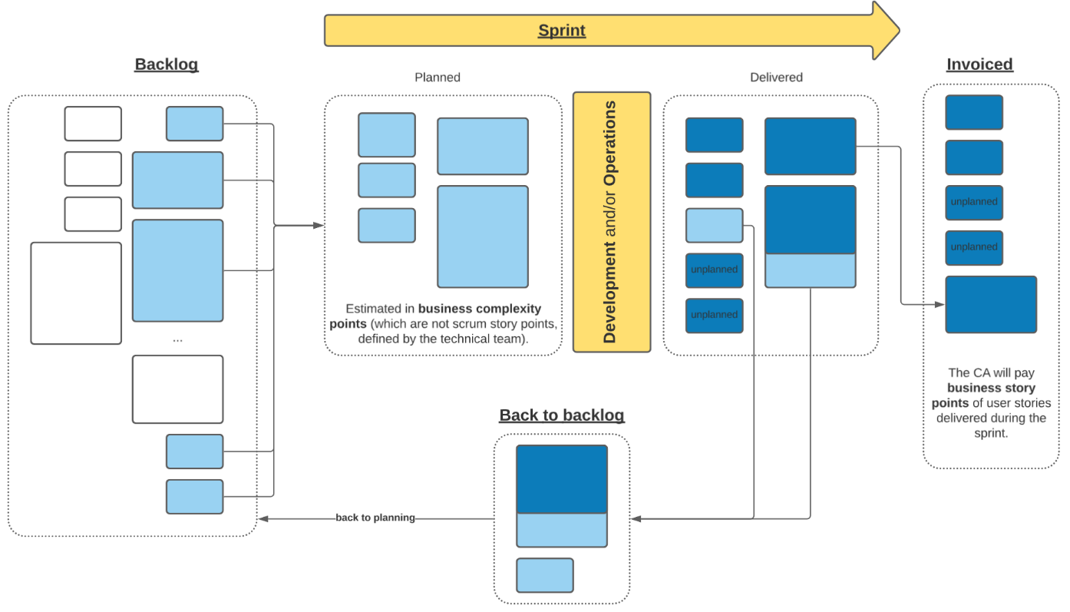
Agile
Customer and Provider agree during the planning phase
The customer is acting as Product Owner, the provider is present with the whole team. They speak in business complexity points which have a certain value in € defined during the award.
The CA pays activities delivered during the sprint, according to the business complexity point value.

Slide 14




Agile
Possible at any moment
Interview
Key personnel
We ask
The market answers
Context, Goal
And geography
Team
Incl. Key personnel CVs
1st
70%
3/6 months backlog
How to start
3/6 month
implementation
All aspects: breakdown in stories, methodologies, tooling…
Quality
2nd
30%
award
Price
3rd
Team expected
Key personnel, composition
…
Specific question (opt.)
Domain specific questions

Slide 15




Activity Based i.e. Quoted T&M / Managed Services
Managed Service
The customer defines catalogue items priced during the award and consumed other a month.
QTM
The customer can define profiles as activities and consume them in quantities
(T-shirts size)
Kanban
Mixed, they allow a versatile Kanban management style; avoid to have complex change requests processes.
Activities to perform
during a month
AND/OR
Activities
Performed
Broker
Catalogue of Activities
Payment

Slide 16
Activity Based i.e. QTM / MS
We ask
The market answers
Possible at any moment
Interview
Key personnel
Context, Goal
And geography
Team
Inc. Key personnel CVs
Activities
Activities expected in the contract with their volumes
Activities implementation
profiles, catalogue items
1st
70%
Quality
2nd
30%
award
Team expected
Key personnel, composition
Price
3rd
Specific question (opt)
Domain specific questions
…

Slide 17
Typical tender
Drafting
What the tendering process aims at
Publish
Quality Evaluation
Fin. Evaluation & Award
Broker
Publishes, receives Q&A, answers Q&A
Broker
Filters (min. formal criteria)
Broker & DG/EUIBA
Evaluates
DG/EUIBA
Draft the specifications
DG/EUIBA
Answers relevant
Q&A
DG/EUIBA
Evaluates
(ranking)
DG/EUIBA
Interviews
(at CA request)
Broker
Support
drafting
10 days to 4+ weeks
1+ week
4+ weeks

Slide 18

We can learn
Customer and Provider agree during the planning phase
With Framework Contracts we were framed for several years in a constrained practice.
With the new approach we are able to adapt constantly our requests and processes to provide a better services to DG/EUIBAs and to the market operators.

Slide 19
Feedback
How to interact with the ProServ broker?

Slide 20



Feedback most welcome on
Level of information provided to market operators
Structure and content of the competitions launched by the broker

Slide 21
How to interact with the broker
For now, following this session, economic operators can provide their feedback via email:
DIGIT-PROSERV-BROKER@ec.europa.eu
Proserv Broker hosted by: DIGIT.C.1

Slide 22
Thank you
© European Union 2024
Unless otherwise noted the reuse of this presentation is authorised under the CC BY 4.0 license. For any use or reproduction of elements that are not owned by the EU, permission may need to be sought directly from the respective right holders.
Slide 8: photo by Markus Winkler, source: Unsplash ; other images by Getty from Unsplash+

