Slide 1
A Recovery plan for Europe:
The Recovery and Resilience Facility
SWEDEN
Meeting of the FICO 28 April 2022

Slide 2




Overview of Sweden’s RRP
27 measures
15 reforms and 12 investments
5 components
€ 3.3 billion
in grants
No loans
23 Milestones & 33 Targets

Slide 3











Assessment summary
Balanced response
Addresses challenges identified in CSRs
Growth, resilience and social impact
Do no
significant harm
A
A
A
A
Green
transition
Digital
transition
Lasting
impact
Effective monitoring and implementation
A
A
A
A
Robust
control systems
Coherence
Reasonable and plausible cost estimates
B
A
A

Slide 4

Key elements of the plan I - green…
Green transition:
“Climate Leap” – support scheme for local and regional climate investments; including the conversion to renewable energy for heating in industry and agriculture, the production of biogas and biofuels, renewables-based refuelling points, charging stations for e-cars as well as the recycling of waste (€811 mn);
“Industry Leap” – support scheme for R&D investments focusing on the low carbon economy and circular economy in the industrial sector (€286 mn);
Protection of high-biodiversity forests (€247 mn);
Strengthened support to improve railway capacity (€148 mn);
Energy efficiency in multi-dwelling buildings (€60 mn).
Reforms increasing the environmental taxation of conventional fuels and promoting the use of sustainable biofuels.
Climate target
44.4%

Slide 5

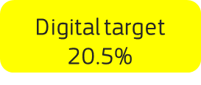
Key elements of the plan II - …and digital
Digital transformation:
High-speed broadband roll-out (€464 mn)
Digital infrastructure for public administration (€21 mn)
Smart technology for energy efficiency in buildings
Study places in higher education focusing on digital skills (€42 mn)

Slide 6




Key elements of the plan III - resilience
Demographic challenge: Gradual increases in the retirement age to improve the sustainability of the public pension system.
Boosting employment: improving employability by expanding vocational training at upper secondary level (€196 mn) and increasing flexibility in the labour market
Research and higher education: scaling up education at universities and other higher education institutions to tackle challenges in the labour market (€308 mn)
Social and health care: improving elderly care by upskilling and training of staff working in centres (€452 mn)
Housing: Increasing the supply of student and new rental dwellings with a lower rent to relief the housing shortage; reducing bottlenecks in permit procedures (€296 mn)

Slide 7

Key elements of the plan IV
European flagships covered: 6
Equality screening: Sweden has good track record on equal opportunities and equality and the plan devotes attention to impact of measures on equality.
Social and territorial cohesion: promoting education and trainignj for disadvantaged groups; broadband roll-out in rural areas to foster an inclusive digital transition and investments to upgrade railways will strengthen cohesion.
Consultation process: Sweden involved regional administrations, social partners, industry and business organisations, non-governmental organisations and educational institutions in the preparatory stage of the plan.

Slide 8

Audit and control – Protection of the EU’s financial interests
  Audit and control systems:
  Rated ‘A’ under Annex V of the RRF Regulation
  The Ministry of Finance is the Coordinating Authority and has the overall responsibility for monitoring and implementation of the plan as a whole.
The implementing bodies are either national authorities (at central, regional, local level) or state agencies/bodies
The overarching audit authority is the Swedish National Financial Management Authority (ESV).
In addition, recurrent audits on efficiency, effectiveness and reliability of accounts are regularly undertaken by the independent National Audit Office (NAO).
Adequate control systems are in place to prevent, detect and correct:
Fraud
Corruption
Conflicts of interest
Double funding

Slide 9
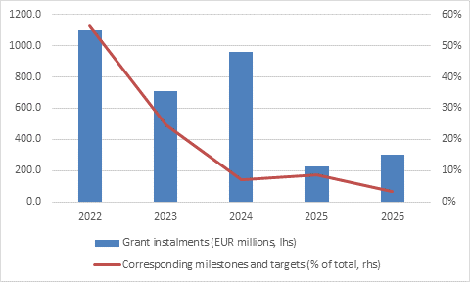
Disbursement profile
* Q1-Q4 202x (paid in 202x+1)

Slide 10
Thank you

